Slide 1
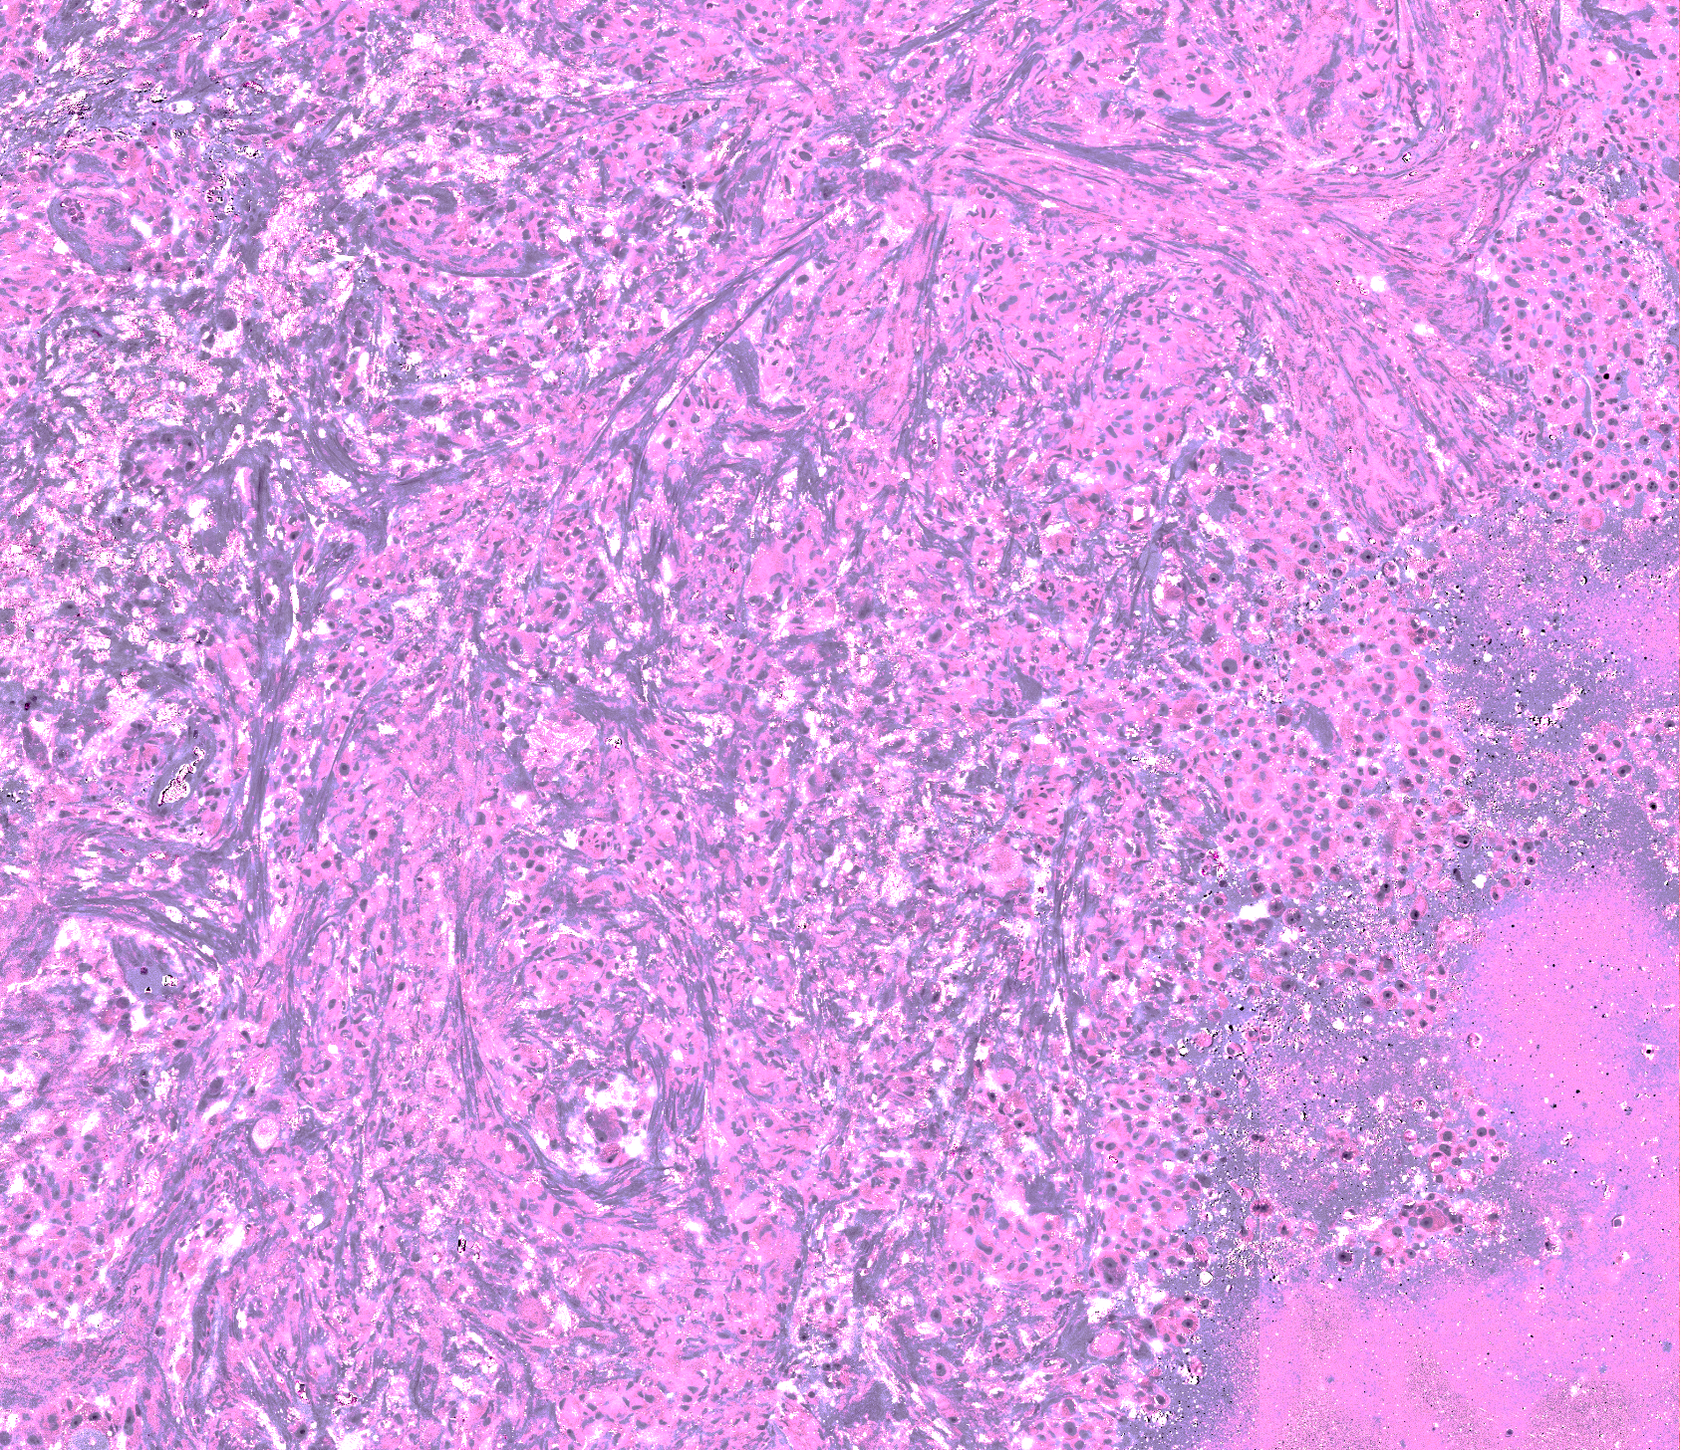
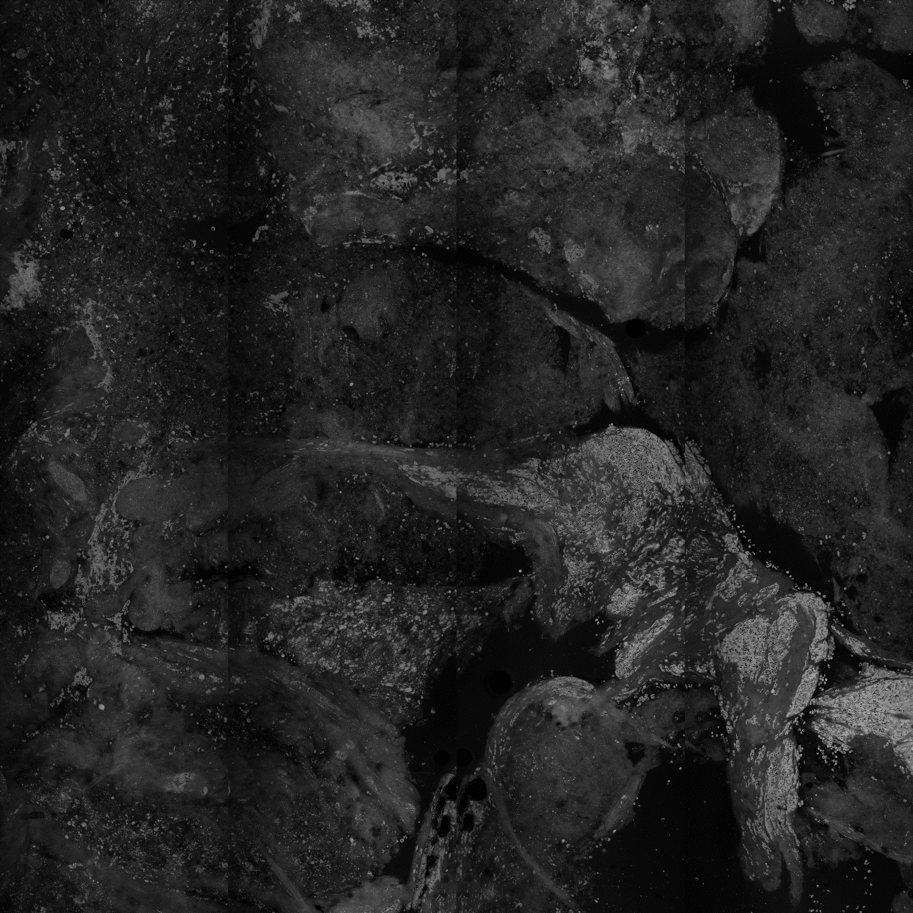



PREDICTING THE PRIMARY TUMOR
OF BRAIN METASTASES
USING STIMULATED RAMAN HISTOLOGY
Mahsa Vali
PhD student, BozekLab / Uniklinik Köln
CANTAR
Sep 2023

Slide 2

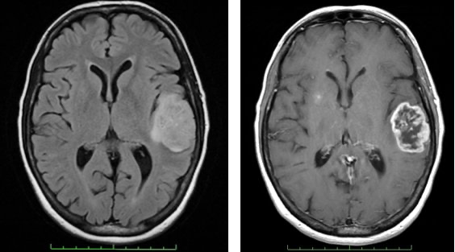
Brain Tumor Diagnosis
An ubiquitous problem in neurosurgical oncology
Diagnosis | Treatment
Glioblastoma | Maximal safe resection
Metastasis | Gross total resection
Lymphoma | Biopsy +/- cytoreduction and IT chemotherapy
Tumefactive multiple sclerosis | Biopsy, anti-inflammatory agents

Slide 3
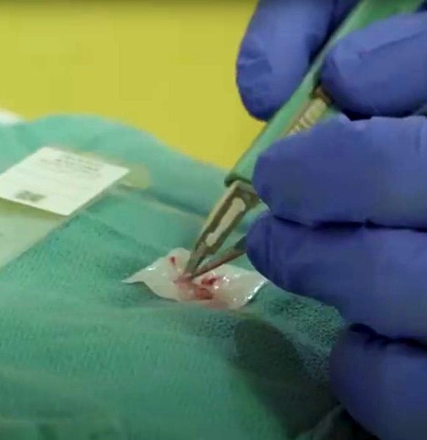
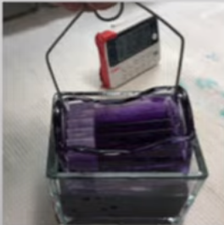
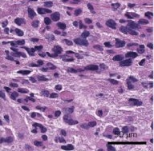
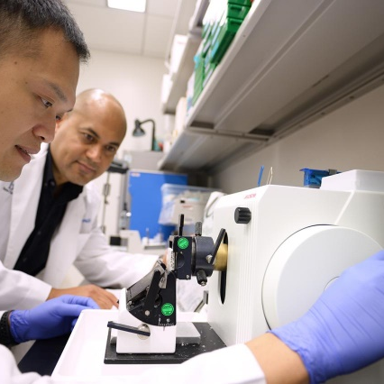
Traditional Diagnosis Workflow
The conventional workflow for intra-operative histology dates back over a century
RESULTS IN UP TO 2 HOURS
tissue extraction
imaging (H&E staining)
interpretation
operating room
outside the operating room
tissue transport to a laboratory
specimen processing
slide preparation by highly trained technicians
interpretation by a pathologist
RESULTS
IN UP TO
2 HOURS

Slide 4
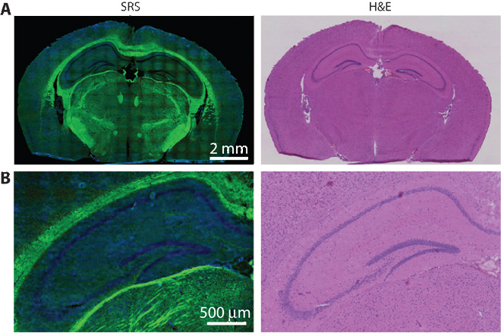
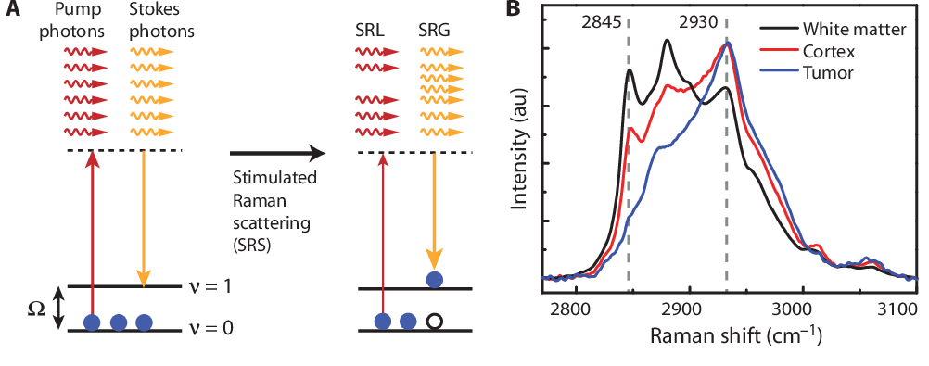
Faster Imaging
via Stimulated Raman Scatting (SRS) Microscopy
Stimulated Raman Scattering:
use 2 laser beams together to achieve a resonance
collect the scattered photons
Freudiger et al., 2008: “Label-free biomedical imaging with high sensitivity by stimulated Raman scattering microscopy”. Science, 322(5909), pp.1857-1861.

Slide 5
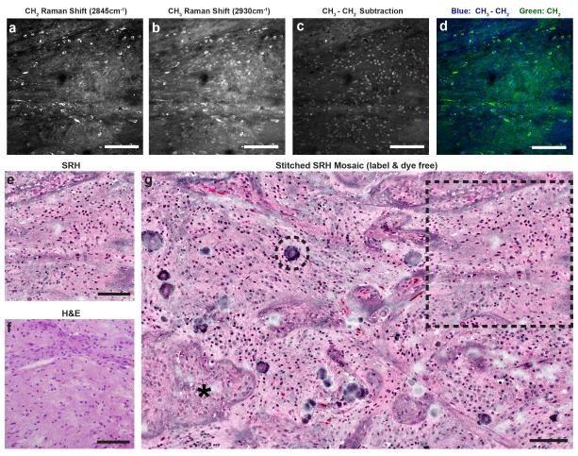
Stimulated Raman Histology (SRH)
Image-processing method which leverages SRS images to create virtual H&E-stained slides, revealing essential diagnostic features.
Orringer et al., 2017: “Rapid intraoperative histology of unprocessed surgical specimens via fibre-laser-based stimulated Raman scattering microscopy”.
Nature biomedical engineering, 1(2), p.0027.

Slide 6
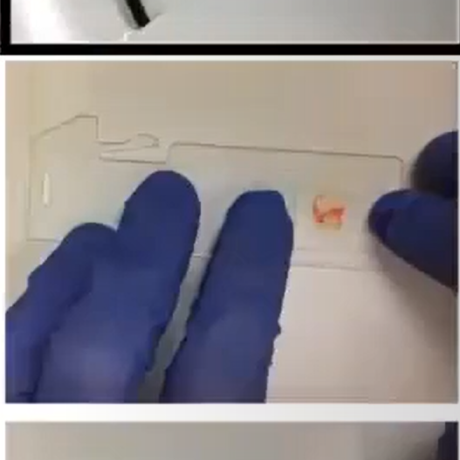
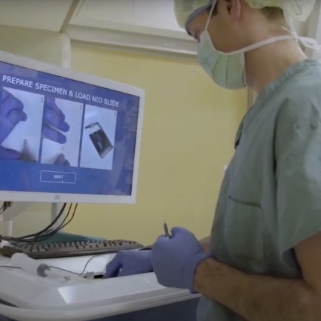
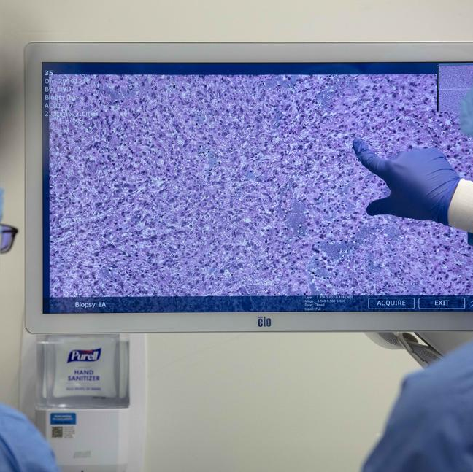

New Diagnosis Workflow
assisted by Machine Learning
by harnessing advances in optics and artificial intelligence
RESULTS
IN 1 MIN
tissue extraction
imaging (SRH)
ML-aided
interpretation
operating room

Slide 7
Predicting the Primary Cancer
based on Stimulated Raman Histology
our goals are to:
Demonstrate the potential of combining SRH with machine learning to improve brain tumor diagnosis.
Compare the diagnostic accuracy of pathologists interpreting conventional histologic images with the accuracy of a Neural Network analyzing SRH images.

Slide 8
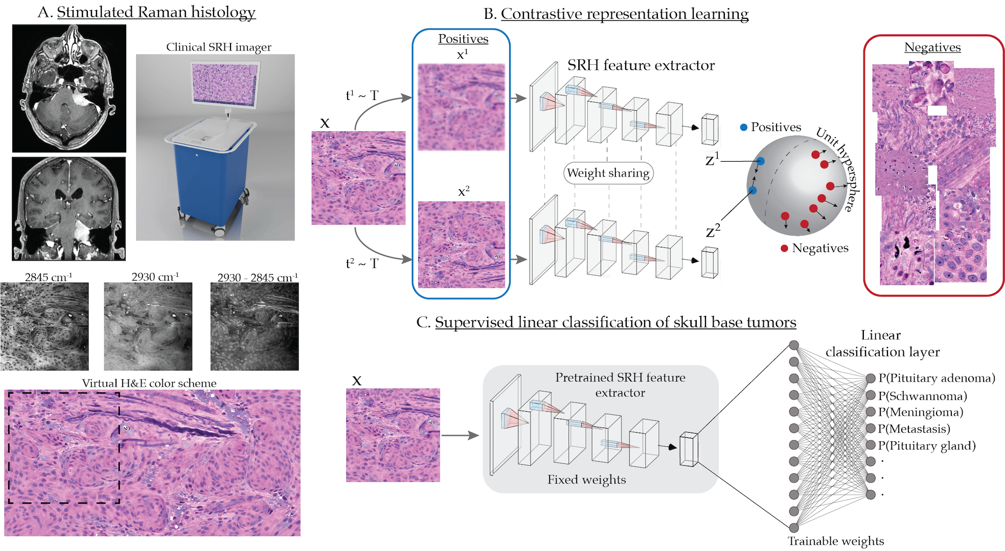




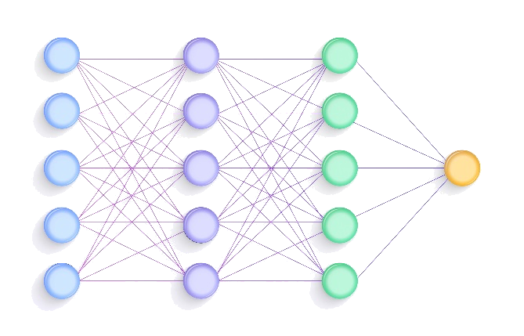
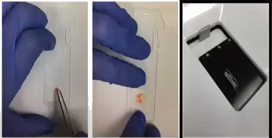

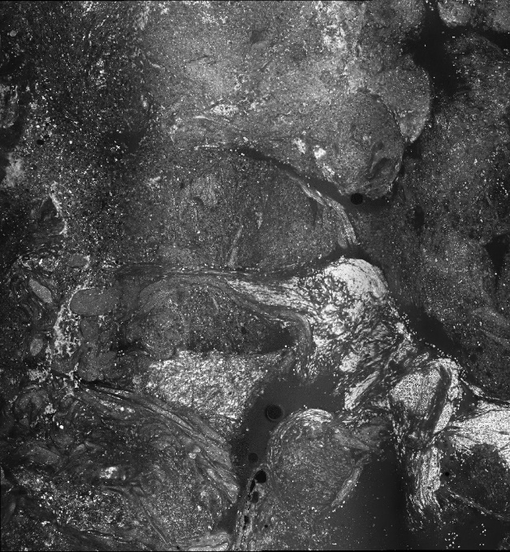
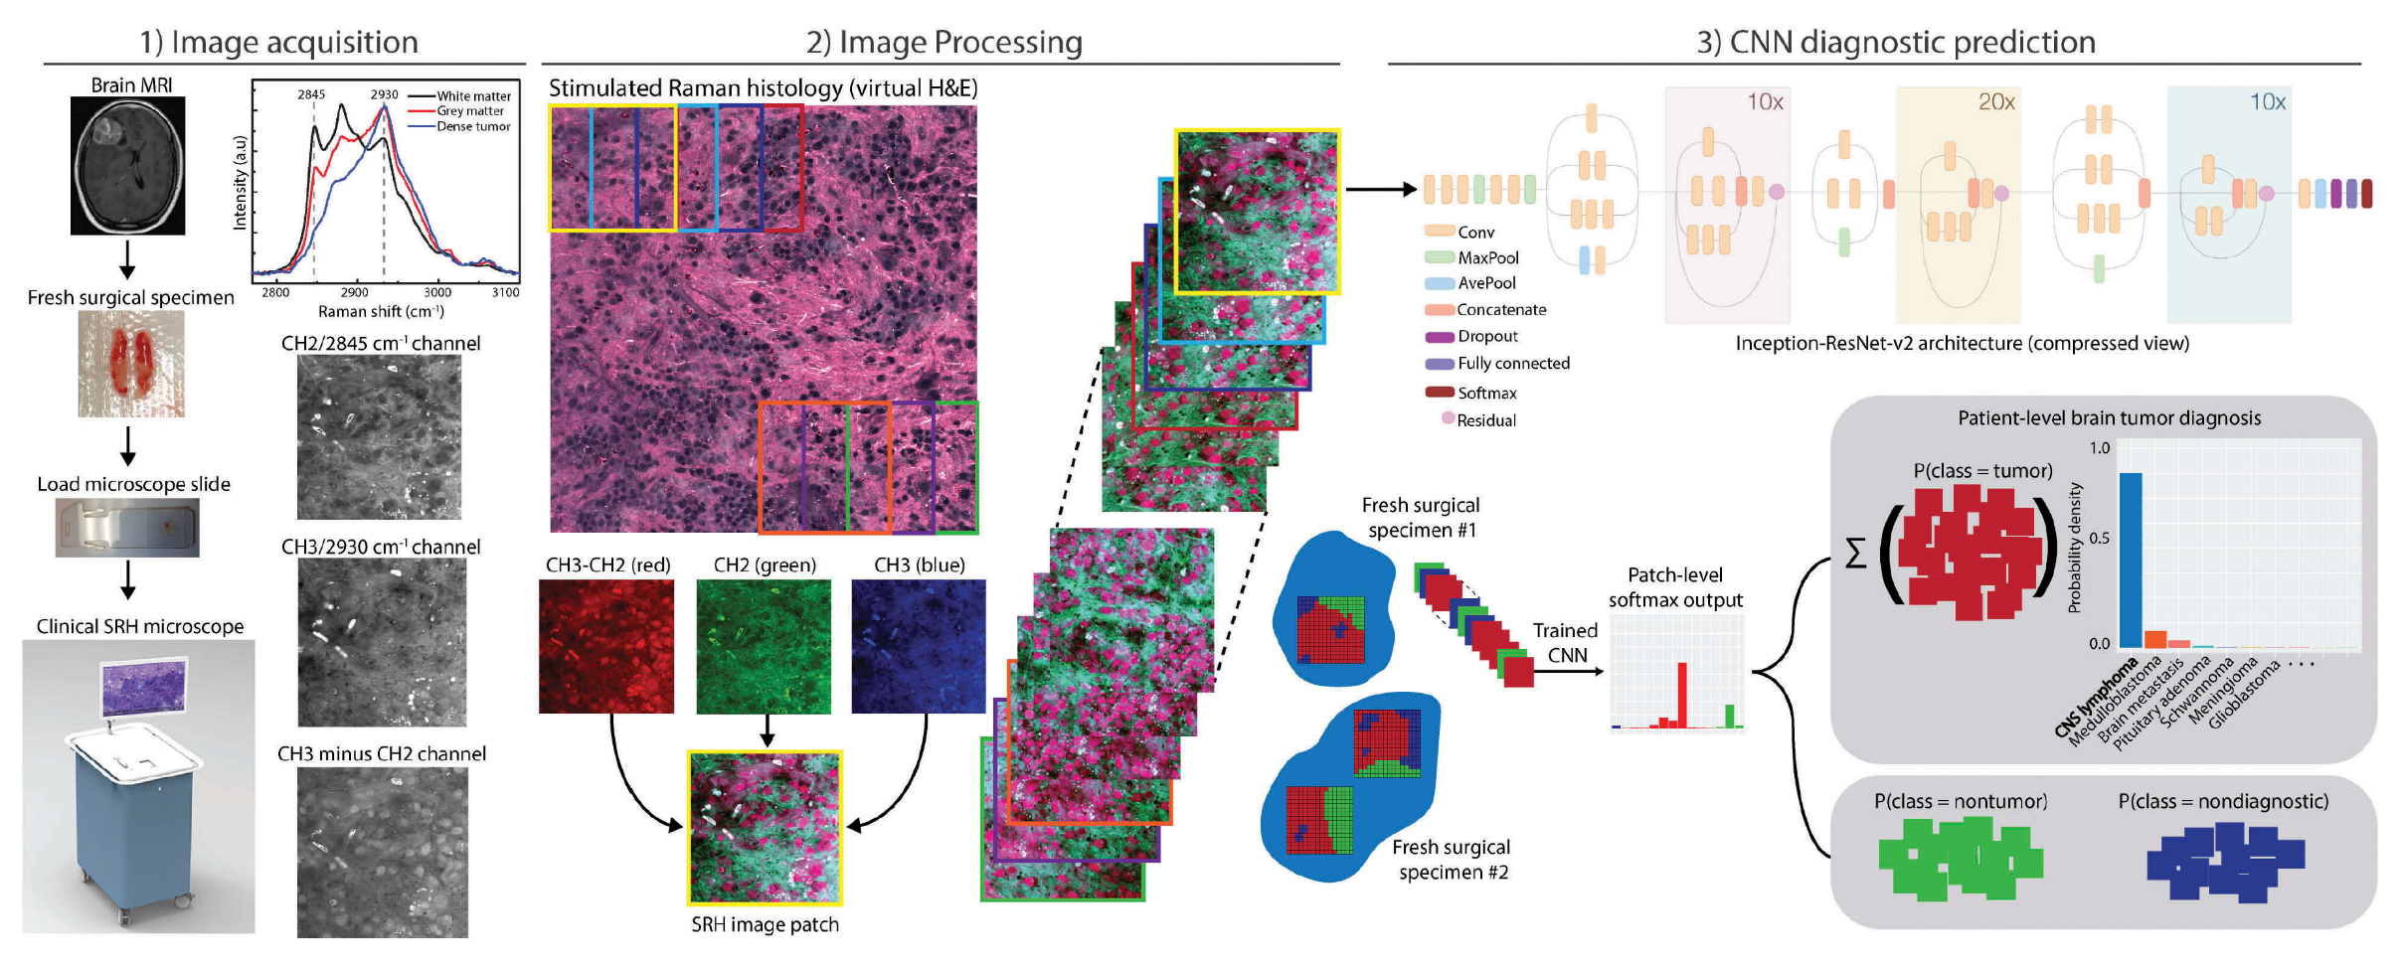
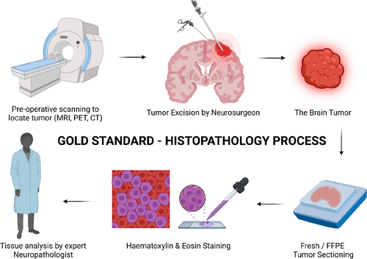
Data Pipeline
from tissue to prediction
Sample preparation
Image acquisition
Image processing
AI Classification
Adenocarcinoma
Hematopoietic
Squamous cell carcinoma
Melanoma
Neuroendocrine carcinoma
Sarcoma
Urothelial carcinoma
intraoperative SRH imaging
primary tumor
tumor excision

Slide 9
Outlook
next steps for the project
in the near future, we will:
explore a range of techniques (classical convolutional neural networks, weakly supervised methods, transformers architectures…)
design interpretability mechanisms providing insights into which image regions are the most informative for the prediction.
inspect and interpret, in collaboration with medical experts, the visual features that the machine learning method is using for prediction

Slide 10




Katarzyna Bozek
Volker Neuschmelting
Anna-Katharina Meißner
Mahsa Vali
Professor of data analytics
in bioinformatics
Neurosurgery
Neurology
Neuroradiology
Neurosurgery
Neuroscience
Neuroradiology
PhD Student

